Slide 1

Opioid Crisis

Slide 2
2,816 Deaths
978 Deaths
35%
Nationally in 2016
In B.C.
B.C. Has the Highest Death Rate in Canada *Stats Canada
Notes:
https://www.canada.ca/content/dam/hc-sc/documents/services/publications/healthy-living/opioids-infographic-eng.pdf

Slide 3
“Wait times can be as long as six months for the places in high demand, but many rehabs won't tell you that. They just say a bed is just coming up.”
CBC News

Slide 4
“There's no drug rehab TripAdvisor — you can only hope that well-meaning people will guide you.”
CBC News
Notes:
http://www.cbc.ca/news/canada/british-columbia/what-we-learned-phoning-every-drug-rehab-facility-in-british-columbia-1.3756425

Slide 5
What Could Be Done?
Notes:
We took a look specifically at individuals who want to seek help and individuals who have family members or loved ones that want them to get the help they need.

Slide 6


Slide 7
Stronger Fit
Stronger Result
F
Notes:
Based on Parameters specified, we will build a profile of the individual and match it to a database of rehab clinics.

Slide 8
How It Works!
Answer Questions
Get Personalized
Results
Start the treatment journey
Or apply for fundraising
Age
Interests
Preferences
Cost
Case severeness
Support networks
Other Criteria
Browse Choices,
Options,
And Details

Slide 9
Features
Waitlists prioritization
Availability notifications
Funding programs matching
Treatment seeker profiles
Data centralization
Treatment fundraising
Step-by-step process for seekers

Slide 10
Benefits
Family/Friend/Patient
One go to place for all the information. Less checking and better results for drug user.
Government
increasing success rate lowers the rate of drug O.D. Less resource drain and happier society.
Rehab Centers
They will be receiving same amounts of patients, but their success rate will increase. Having centralized system allows for reduced influx in denial of care.

Slide 11
Comparison
Normal Process
No centres comparison
No priority provided
No updated numbers
Fail to find = leave search
REHMAP
Extensive comparison and filtration
Chance of a better place on waitlists
Accurate updated data
Seekers will be always helped!

Slide 12
Desktop project

Slide 13
Our deployment process is simple
Complete Program
(4-5 Months Alpha)
Deploy With Rehab Centers On Board
Contacting Vancouver Coastal Health Service

Slide 14
Future Features
Social Platform
Building a community of friend on the same journey.
Social Support
Build the positive community and get the social services support in a centralized manner.
Hobbies and Development
Making positive habits stick and keeping users busy so that relapse is not possible.
Blog Thread Community
Communicating,sharing, and reading similar shared experiences through one centralized platform.
Beneficiaries/Donor
Charity and donor system to help those without sufficient money to get the help they need.
Detailed Reports for Family
Keep family and friends in the loop on user’s recovery process and help pinpoint what more can be done.

Slide 15
You can’t beat a bad habit by tackling the habit itself.
The root matters!

Slide 16
One Step Beyond

Slide 17
MEET JJ
Our Artificial Profile Developed Through Machine Learning

Slide 18
J.J
Machine learning developed profile based on all the data collected from the individuals who have been through REHMAP system. J.J. will be final extension of the project where we will have sufficient data to be able to determine how likely is a given type of scenario likely to lead to drug addiction.

Slide 19
Comprehensive Solution
Prevention
Well Rounded Solution
Treatment

Slide 20
Thanks!
Any questions?

Slide 21
And tables to compare data
 | A | B | C
Yellow | 10 | 20 | 7
Blue | 30 | 15 | 10
Orange | 5 | 24 | 16

Slide 22

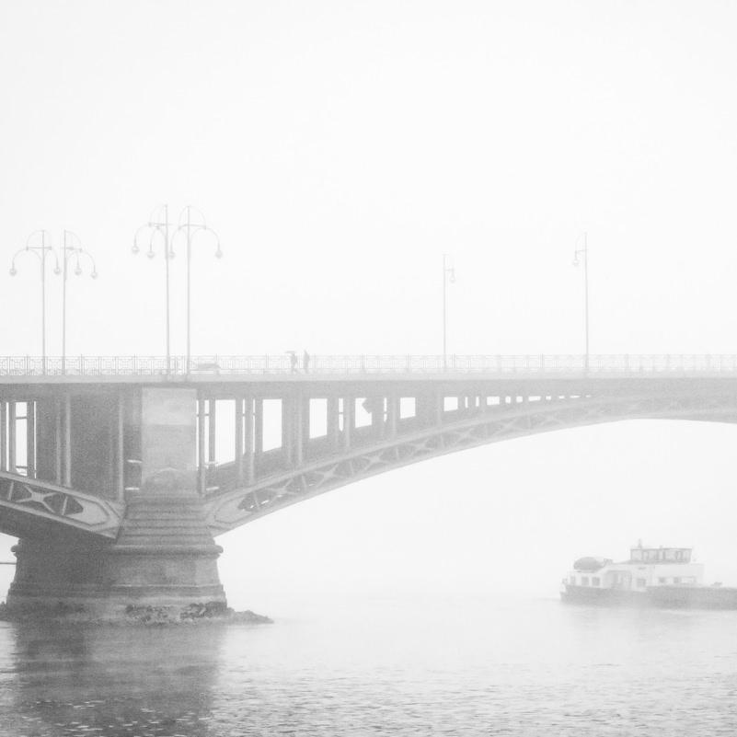

A picture is worth a thousand words
A complex idea can be conveyed with just a single still image, namely making it possible to absorb large amounts of data quickly.

Slide 23
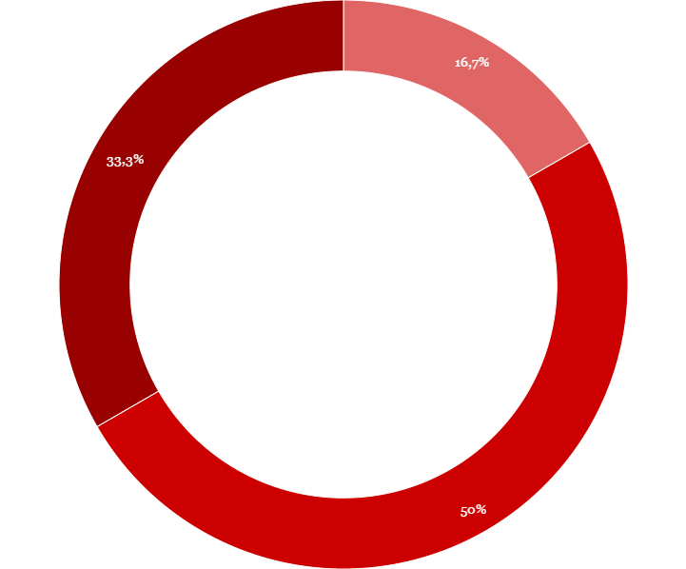
You can copy&paste graphs from Google Sheets

Slide 24
SlidesCarnival icons are editable shapes.
This means that you can:
Resize them without losing quality.
Change fill color and opacity.
Change line color, width and style.
Isn’t that nice? :)
Examples:

